Slide 1
EMBEDDED SYSTEMS
TRAFFIC LIGHT
BY
SYED MUHAMMAD ABIS RIZVI
IBRAHIM ABD MALEK
GITHUB-LINK: https://github.com/ibrahimabdelmalek31/Embedded-Systems-Team-D01

Slide 2
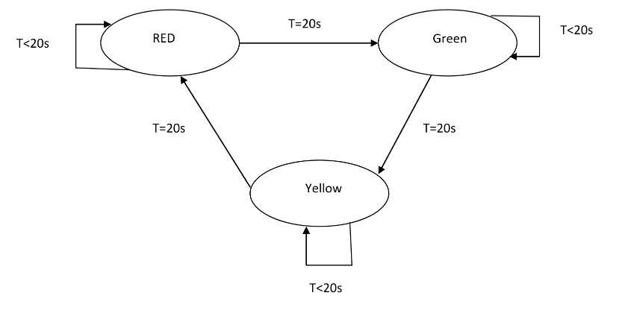
STATE MACHINE DIAGRAM TASK 1

Slide 3
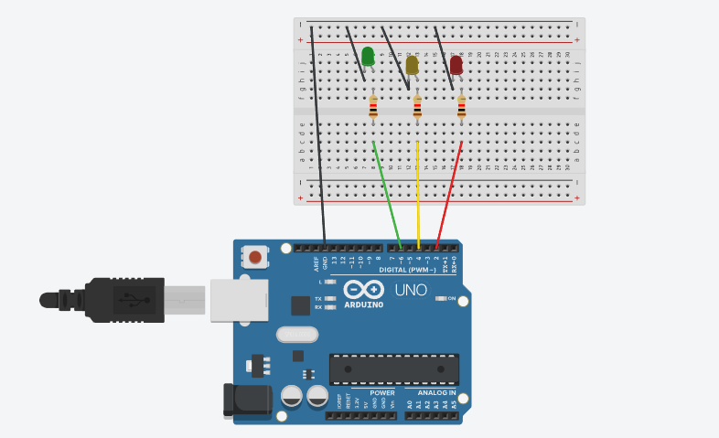
TASK 1

Slide 4
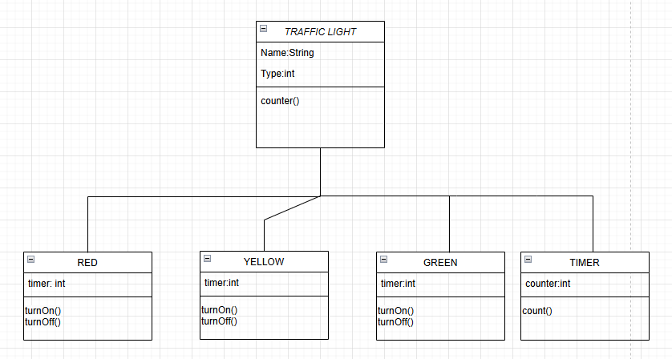
CLASS DIAGRAM TASK 1

Slide 5
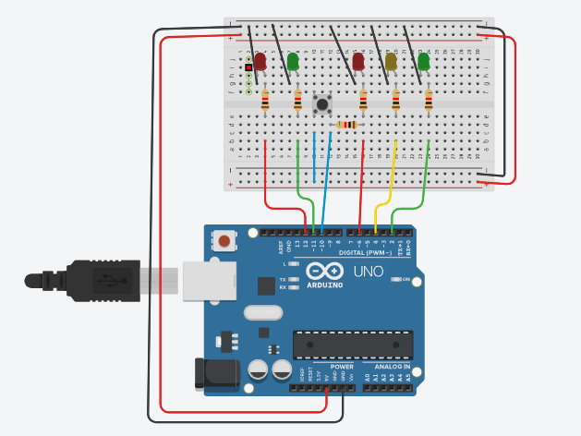
TASK 2

Slide 6
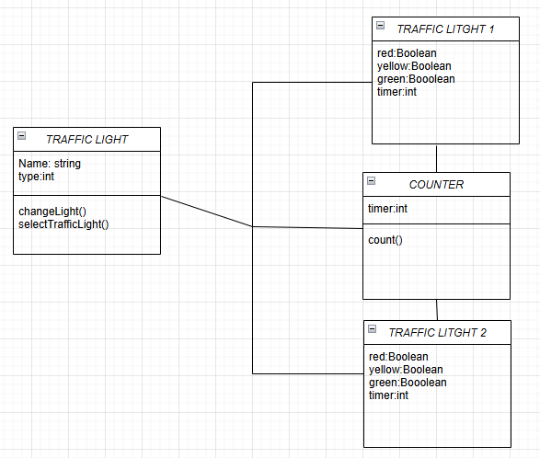
CLASS DIAGRAM TASK 2

Slide 7
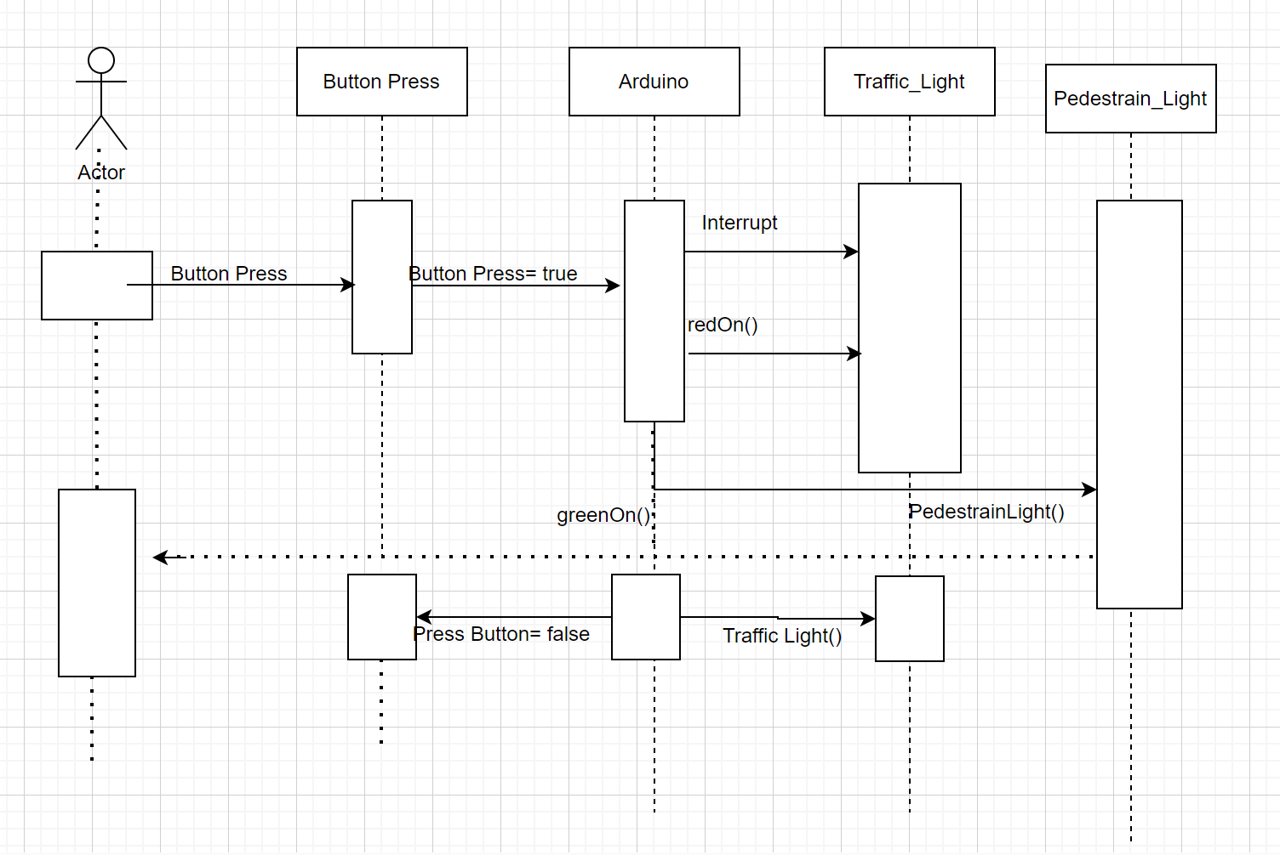
TASK 5
SEǪUENCE DIAGRAM

Slide 8
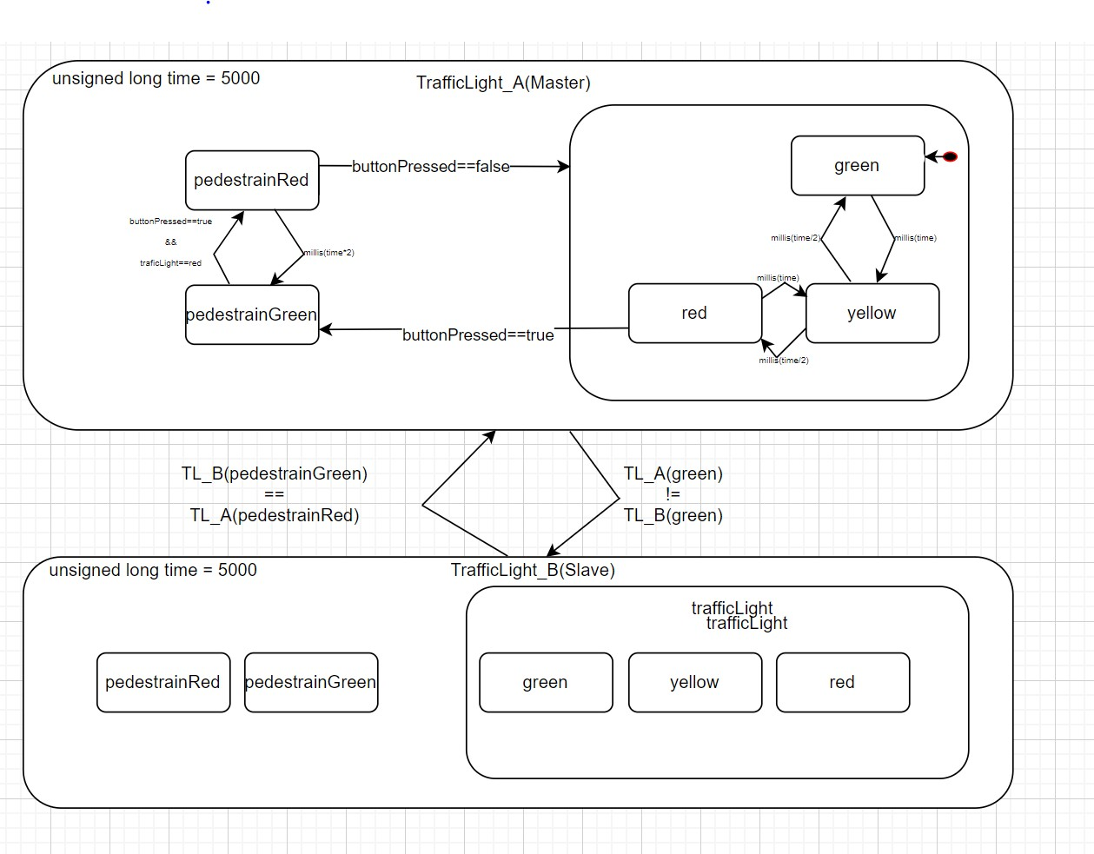
STATE MACHINE DIAGRAM

Slide 9
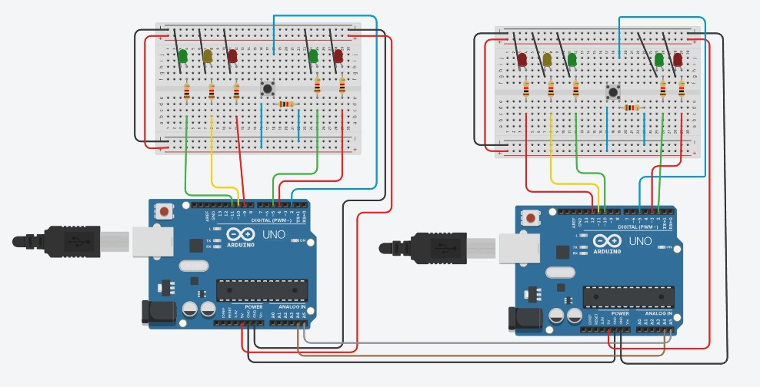
TRAFFIC LIGHT HAVING TWO MICROCONTROLLERS

Slide 10
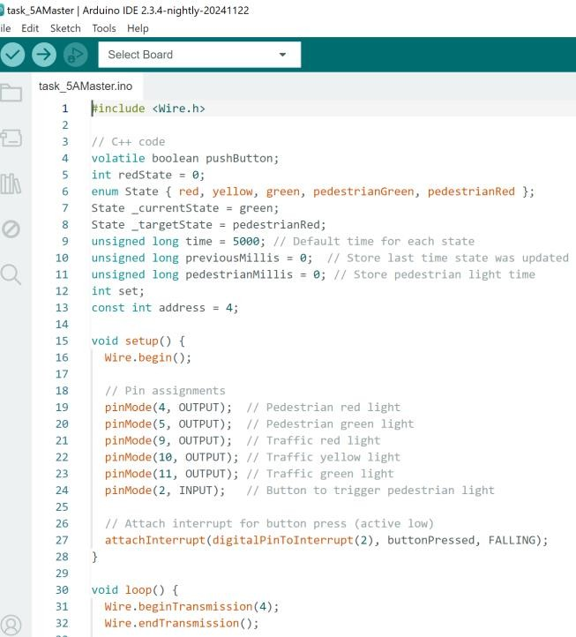
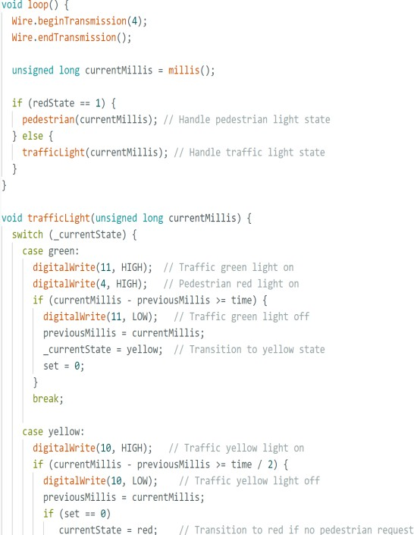
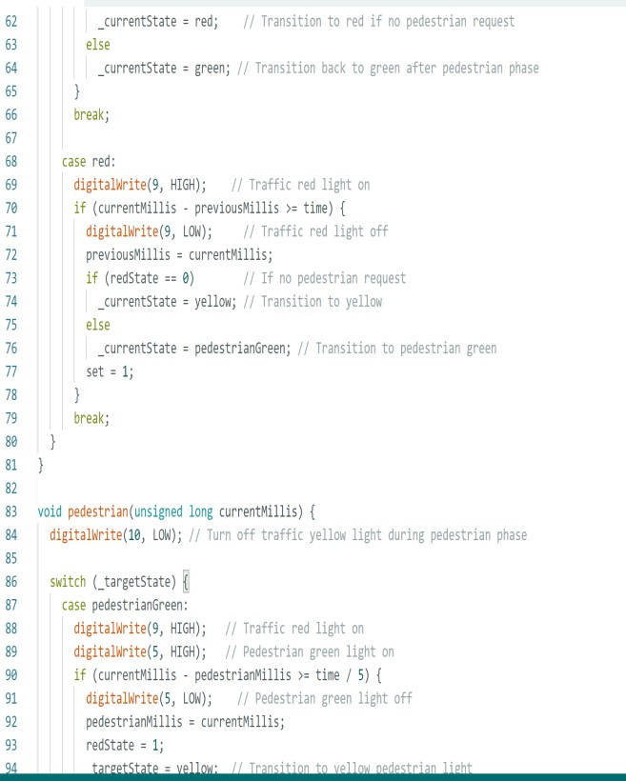
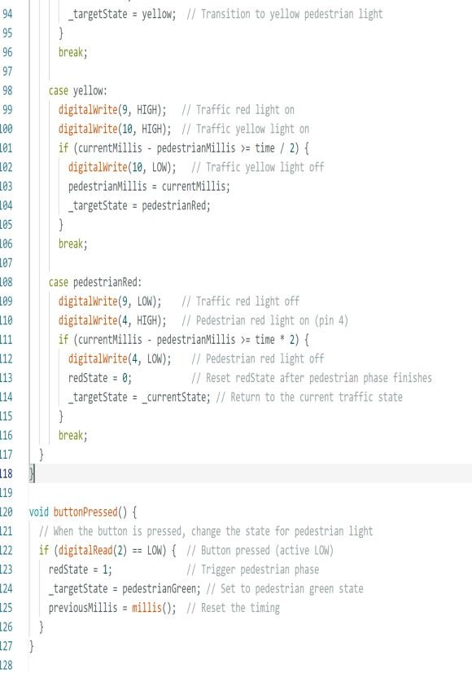
MASTER -CODE

Slide 11
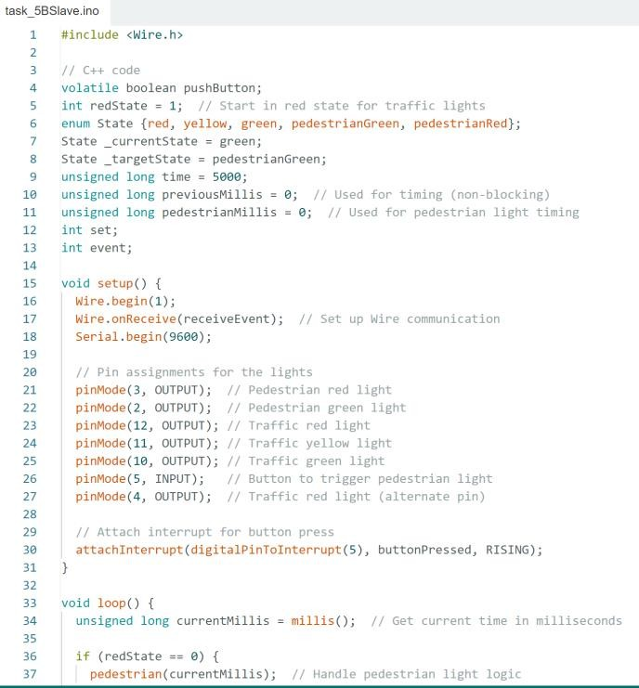
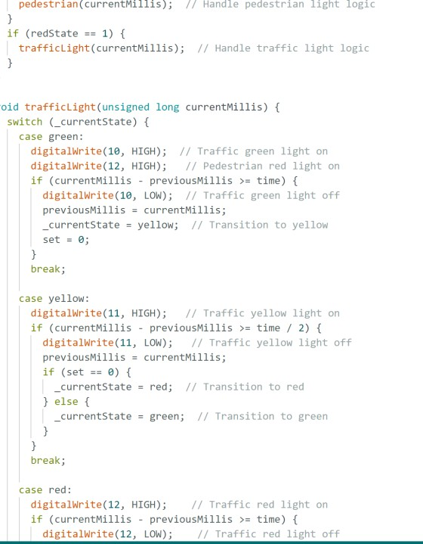
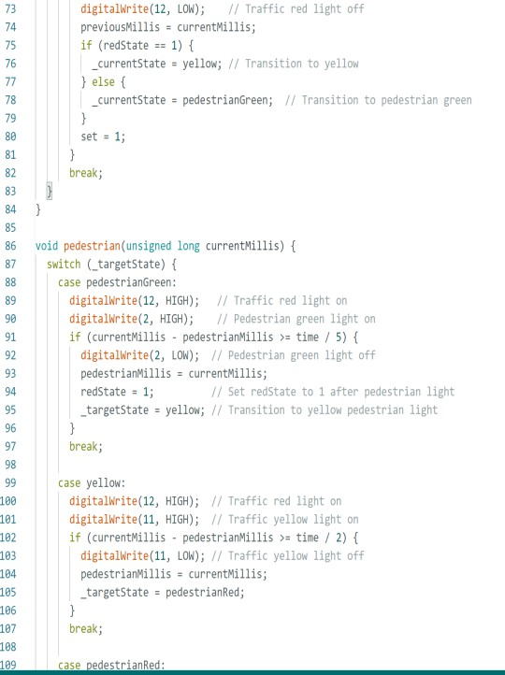
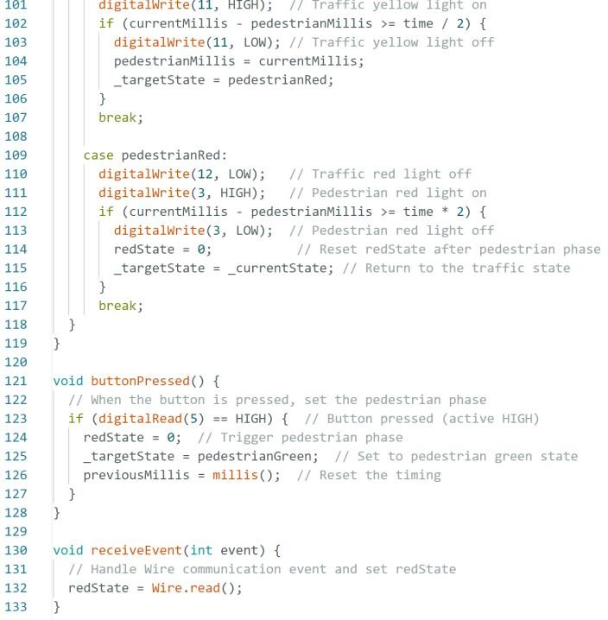
SLAVE-CODE

Slide 12
THANK YOU.

Slide 13
